Slide 1
DATABASE
DBMS.
RDMS.
MySQL.
By
Pradeep E
Programmer Analyst - Trainee

Slide 2

DATABASE

Slide 3
What is Database?
A database is a collection of data that is organized and stored in a way that allows for efficient retrieval, management, and manipulation of information.
Retrieval – Querying
Management – Storage and Maintenance of data
Data Security
Backup and Recovery
Manipulation – Performing operation on the data
Querying , Updating
Inserting , Deleting

Slide 4
Types of Databases
There are several types of databases, each designed to address specific data storage and management requirements. Here are some common types of databases:
Relation Database
Hierarchical Database
NoSql Database
Key Value
Document – Based
Graph – Based

Slide 5
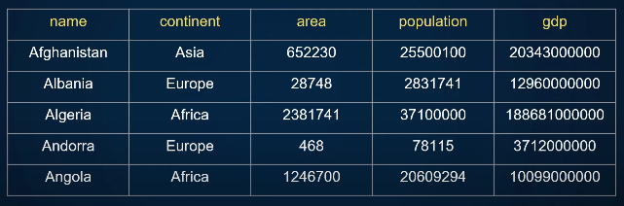
Relational Database
Relational databases store data in structured tables with rows and columns. Example : MySQL

Slide 6
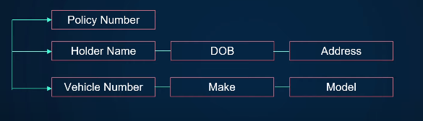
Hierarchical Database
A hierarchical database is a type of database model where data is organized in a parent-child relationships.

Slide 7

NoSql Database
NoSQL databases are designed to handle various types of unstructured, semi-structured, or highly dynamic data. They offer more flexibility in data storage and retrieval. Types of NoSQL databases include:
Key-Value : Store data as key-value pairs. Example: Amazon DynamoDB.

Slide 8


Document – Based : Store data as documents (e.g., JSON). Example: MongoDB.
Graph Databases: Store data as nodes and edges to represent relationships. Example: Neo4j.

Slide 9

DBMS
Interface between database and end user
Software to store, retrieve, define and manage data in database
Easy CRUD operations
Takes care of authentication, backup, optimization etc.

Slide 10
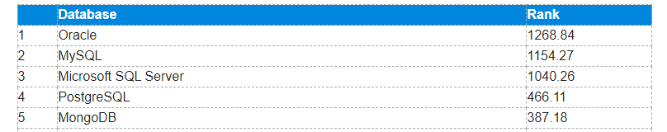
RDBMS
MySQL – Open Source
SQL Server – Microsoft
Oracle - IBM
PostgreSQL – Open Source
Ranking of the Most popular database management system worldwide 2023

Slide 11
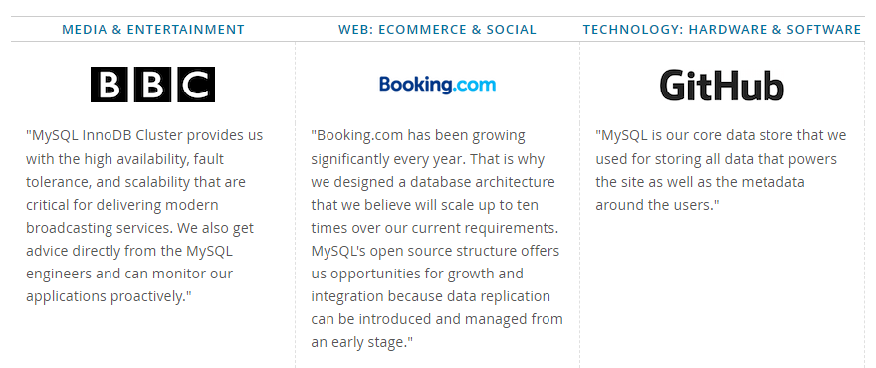
MySQL Customers

Slide 12
SQL with MySQL DBMS
SQL
SQL stands for Structured Query Language
SQL lets you access and manipulate databases
SQL became a standard of the American National Standards Institute (ANSI) in 1986, and of the International Organization for Standardization (ISO) in 1987

Slide 13
What Can SQL do?
SQL can execute queries against a database
SQL can retrieve data from a database
SQL can insert records in a database
SQL can update records in a database
SQL can delete records from a database
SQL can create new databases
SQL can create new tables in a database

Slide 14
Keep in mind that…
SQL keywords are NOT case sensitive: select is same as SELECT.
Semicolon after SQL Statements?
Semicolon is the standard way to separate each SQL statement in database systems that allow more than one SQL statement to be executed in the same call to the sever.

Slide 15
Some of The Most Important SQL Commands
SELECT - extracts data from a database
UPDATE - updates data in a database
DELETE - deletes data from a database
INSERT INTO - inserts new data into a database
CREATE DATABASE - creates a new database
ALTER DATABASE - modifies a database
CREATE TABLE - creates a new table
ALTER TABLE - modifies a table
DROP TABLE - deletes a table

Slide 16
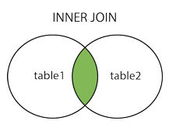
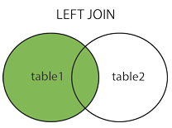
SQL JOIN
INNER JOIN : Return records that have matching values in both tables.
LEFT JOIN : Returns all records from the left table, and the matched records from the right table

Slide 17
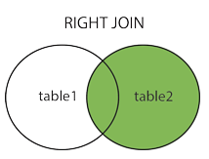
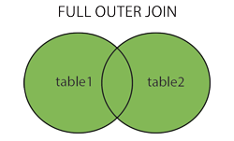
RIGHT JOIN : Returns all records from the right table, and the matched records from the left table
FULL OUTER JOIN : Return all records when there is a match in either left or right table.

Slide 18
UNIQUE
UNIQUE constraints provide a guarantee for uniqueness for a column or set of columns.
However, we can have many UNIQUE constraints per table.
PRIMARY KEY
PRIMARY KEY must contain UNIQUE values, and cannot contain NULL values.
A table can have only ONE primary key; and in the table, this primary key can consist of single or multiple columns (fields).

